Slide 1
●
○
○
○
○

Slide 2

●
○
○

Slide 3
>>> housing = strat_train_set.drop("median_house_value", axis=1)
>>> housing_labels = strat_train_set["median_house_value"].copy()
Note- drop() creates a copy of the data and does not affect strat_train_set

Slide 4


Slide 5

●
●

Slide 6
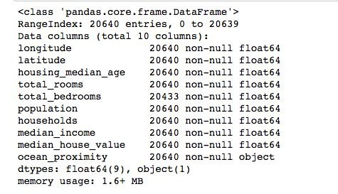



●

Slide 7
●
○
○
○

Slide 8
●
○
○
○

Slide 9
●
>>> sample_incomplete_rows = housing[housing.isnull().any(axis=1)].head()
Run it in Notebook

Slide 10
dropna()
>>> sample_incomplete_rows.dropna(subset=["total_bedrooms"])

Slide 11

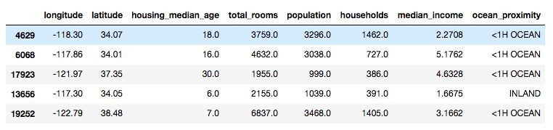
drop()
>>> sample_incomplete_rows.drop("total_bedrooms", axis=1)

Slide 12
fillna()
●
>>> median = housing["total_bedrooms"].median()
>>>
sample_incomplete_rows["total_bedrooms"].fillna(median, inplace=True)
>>> sample_incomplete_rows
Run it in Notebook

Slide 13
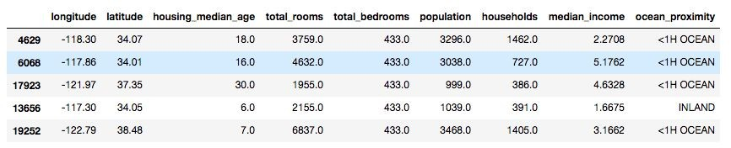
fillna()

Slide 14

●
○
○
○
●
○

Slide 15


●
○
●
●
○

Slide 16
●
●
>>> from sklearn.impute import SimpleImputer
>>> imputer = SimpleImputer(strategy="median")

Slide 17

●
○
●
○
>>> housing_num = housing.drop("ocean_proximity", axis=1)

Slide 18

●
●
>>> imputer.fit(housing_num)

Slide 19


●
○
○
○

Slide 20
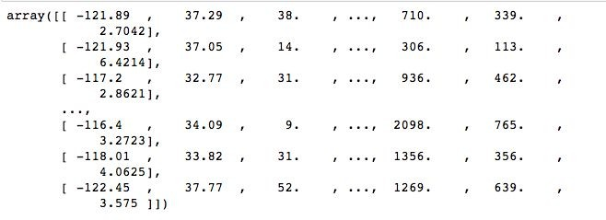

●
>>> X = imputer.transform(housing_num)
>>> X

Slide 21
●
>>> housing_tr = pd.DataFrame( X,
columns=housing_num.columns
)
>>> housing_tr.head()

Slide 22
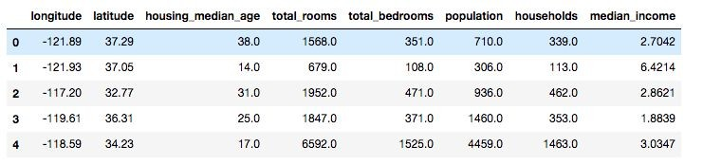

Slide 23


Slide 24
●
●

Slide 26


●
●

Slide 27
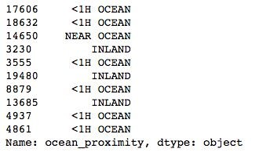
>>> housing_cat = housing['ocean_proximity']
>>> housing_cat.head(10)

Slide 28
>>> df = pd.DataFrame({
'A':['type1','type3','type3', 'type2', 'type0']
})
>>> df['A'].factorize()

Slide 29
>>> housing_cat_encoded, housing_categories = housing_cat.factorize()
>>> housing_cat_encoded[:10]
Output-
array([0, 0, 1, 2, 0, 2, 0, 2, 0, 0])

Slide 30

>>> housing_categories
Index(['<1H OCEAN', 'NEAR OCEAN', 'INLAND', 'NEAR BAY',
'ISLAND'], dtype='object')

Slide 31

●
○
○
○
●
○

Slide 32



●
○
●
○
■
■
○
■
■

Slide 33
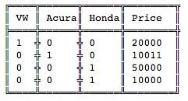
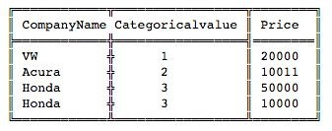



Slide 34

●
○
○
●

Slide 35
>>> from sklearn.preprocessing import OneHotEncoder
>>> encoder = OneHotEncoder()
>>> housing_cat_1hot = encoder.fit_transform(housing_cat_encoded.reshape(-1,1))
>>> housing_cat_1hot
Output -

Slide 36
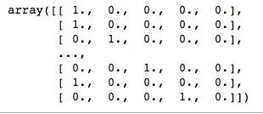
●
●
>>> housing_cat_1hot.toarray()

Slide 37




Slide 39
●
○
○
●
○
●

Slide 40
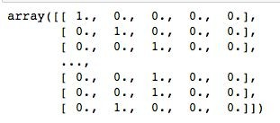
>>> cat_encoder = CategoricalEncoder(encoding="onehot-dense")
>>> housing_cat_reshaped = housing_cat.values.reshape(-1, 1)
>>> housing_cat_1hot = cat_encoder.fit_transform(housing_cat_reshaped)
>>> housing_cat_1hot

Slide 41
>>> cat_encoder.categories_

Slide 43
●
○
○

Slide 44


●
○
○

Slide 45

●
●
fit()
transform()
fit_transform()
Or add TransformerMixin as a base class instead of fit_transform

Slide 46
●
●
○
○

Slide 47


Slide 48
●
●
●

Slide 49


Slide 50


●
○
○

Slide 51
●
○
○

Slide 53

●
○
●
○
○

Slide 54
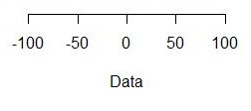

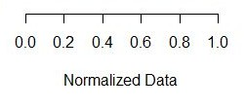
●
●

Slide 55

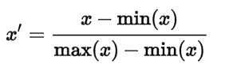

●
●

Slide 56
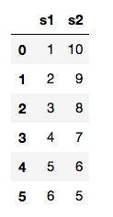
# Creating DataFrame first
>>> import pandas as pd
>>> s1 = pd.Series([1, 2, 3, 4, 5, 6], index=(range(6)))
>>> s2 = pd.Series([10, 9, 8, 7, 6, 5], index=(range(6)))
>>> df = pd.DataFrame(s1, columns=['s1'])
>>> df['s2'] = s2
>>> df

Slide 57
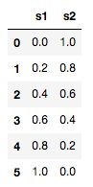
# Use Scikit-Learn minmax_scaling
>>> from mlxtend.preprocessing import minmax_scaling
>>> minmax_scaling(df, columns=['s1', 's2'])

Slide 58

●
○
○
○

Slide 59
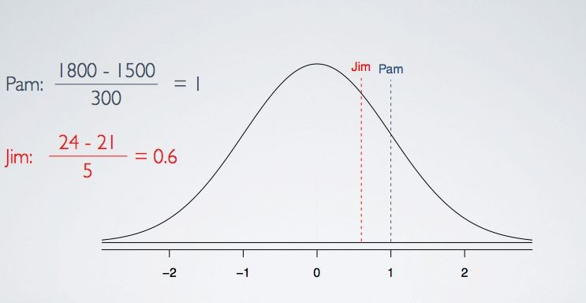
○

Slide 60
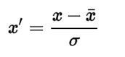

●
○
○
○

Slide 61


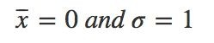


●
●
●
○
○

Slide 62
●
○

Slide 63
●
●
○
○
●

Slide 65
●
○
○
○

Slide 66


●
●
○
○
○

Slide 67
●
>>> from sklearn.pipeline import Pipeline
>>> from sklearn.preprocessing import StandardScaler
>>> num_pipeline = Pipeline([
('imputer', SimpleImputer(strategy="median")), ('attribs_adder', CombinedAttributesAdder()), ('std_scaler', StandardScaler()),
])
>>> housing_num_tr = num_pipeline.fit_transform(housing_num)

Slide 68



●
●
num_pipeline = Pipeline([
('imputer', SimpleImputer(strategy="median")),
………………
………………

Slide 69

●
○
○
○
○

Slide 70
●
●
●
○

Slide 71
class DataFrameSelector(BaseEstimator, TransformerMixin): def init (self, attribute_names):
self.attribute_names = attribute_names def fit(self, X, y=None):
return self
def transform(self, X):
return X[self.attribute_names].values

Slide 72
●
>>> num_attribs = list(housing_num)
>>> num_pipeline = Pipeline([
('selector', DataFrameSelector(num_attribs)), ('imputer', SimpleImputer(strategy="median")), ('attribs_adder', CombinedAttributesAdder()), ('std_scaler', StandardScaler()),
])

Slide 73
●
>>> cat_attribs = ["ocean_proximity"]
>>> cat_pipeline = Pipeline([
('selector', DataFrameSelector(cat_attribs)),
('cat_encoder', CategoricalEncoder(encoding="onehot-dense")),
])

Slide 74
num_pipeline
●
cat_pipeline
>>> from sklearn.pipeline import FeatureUnion
>>> full_pipeline = FeatureUnion(transformer_list=[ ("num_pipeline", num_pipeline), ("cat_pipeline", cat_pipeline),
])

Slide 75

●
●
●
●

Slide 76
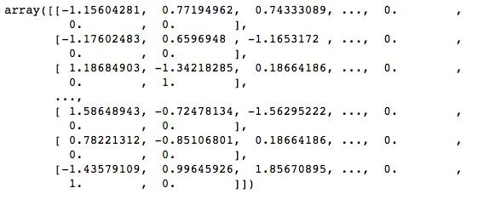
●
>>> housing_prepared = full_pipeline.fit_transform(housing)
>>> housing_prepared

Slide 77



Slide 79


●
●
●
●
○
○
●

Slide 80
●
○
○
●

Slide 81
●
●
●
○
●

Slide 82

●
●
●
○
○

Slide 83


●
●
●

Slide 85
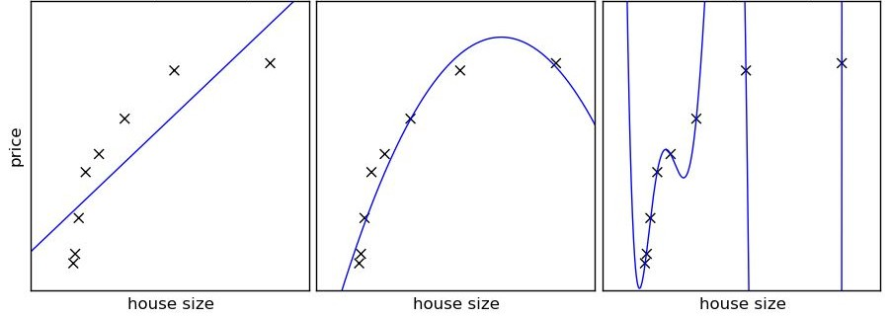

Slide 87


●
●
●
●

Slide 88


●
●

Slide 89

●
●

Slide 90


●
●

Slide 91

●
●

Slide 92
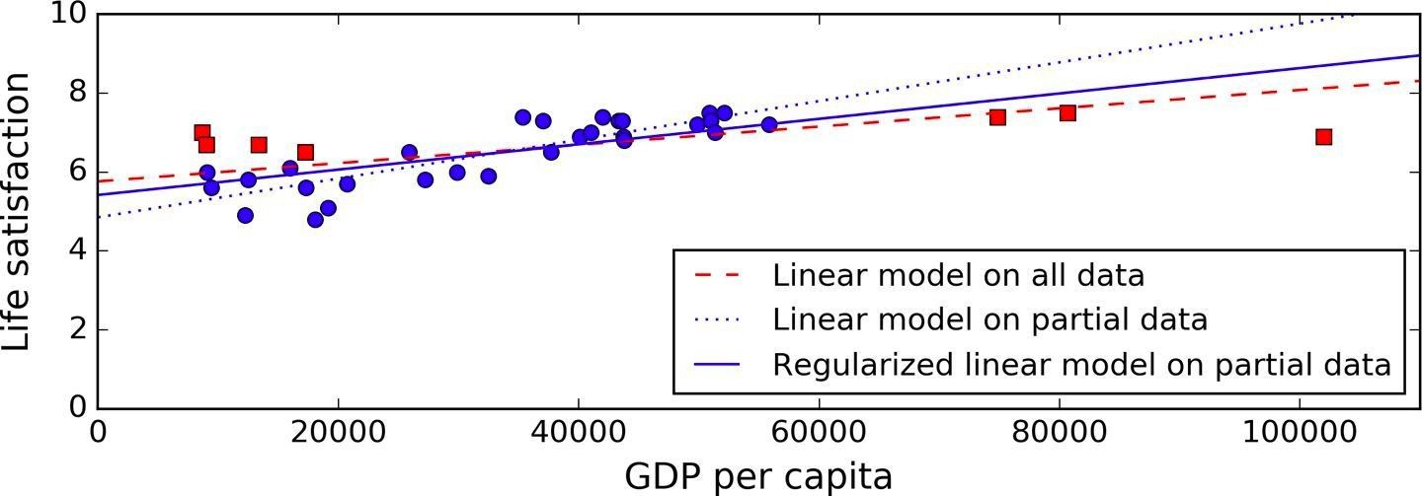
The dotted line represents the original model that was trained with a few countries missing.

Slide 93
The dashed line is our second model trained with all countries

Slide 94
The solid line is a linear model trained with the same data as the first model but with a regularization constraint.

Slide 95
Observations from the above example:
Regularization forced the model to have a smaller slope
Fits a bit less on the training data that the model was trained on
But actually allows it to generalize better to new examples.

Slide 96
●
●

Slide 98


●
●
●

Slide 99
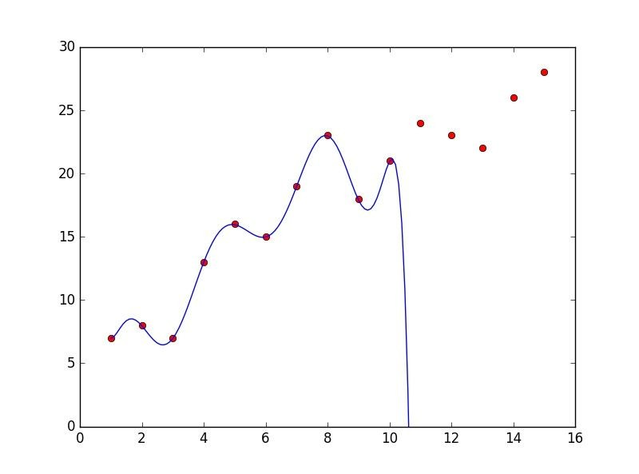
In the above plot the model doesn’t fit perfectly on the training data, hence it is a case of underfitting.

Slide 100

●
●
●

Slide 102


>>> from sklearn.linear_model import LinearRegression
>>> lin_reg = LinearRegression()
>>> lin_reg.fit(housing_prepared, housing_labels)
Training Set
Target Column

Slide 103
>>> from sklearn.linear_model import LinearRegression
>>> lin_reg = LinearRegression()
>>> lin_reg.fit(housing_prepared, housing_labels)
Training Set
Target Column

Slide 104
●
>>> some_data = housing.iloc[:5]
>>> some_labels = housing_labels.iloc[:5]
>>> some_data_prepared = full_pipeline.transform(some_data)
>>> print("Predictions:", lin_reg.predict(some_data_prepared))
>>> print("Actual values", list(some_labels))

Slide 105





Slide 106
●
●

Slide 107

●
●

Slide 108
>>> from sklearn.metrics import mean_squared_error
>>> housing_predictions = lin_reg.predict(housing_prepared)
>>> lin_mse = mean_squared_error(housing_labels, housing_predictions)
>>> lin_rmse = np.sqrt(lin_mse)
>>> lin_rmse
>>> 68628.413493824875

Slide 109

>>> lin_rmse
>>> 68628.413493824875
●
○
○
○
●
○

Slide 110
●
●

Slide 111
●
●

Slide 112
>>> from sklearn.tree import DecisionTreeRegressor
>>> tree_reg = DecisionTreeRegressor()
>>> tree_reg.fit(housing_prepared, housing_labels)

Slide 113
>>> housing_predictions = tree_reg.predict(housing_prepared)
>>> tree_mse = mean_squared_error(housing_labels, housing_predictions)
>>> tree_rmse = np.sqrt(tree_mse)
>>> tree_rmse
Output - 0.0

Slide 114
>>> housing_predictions = tree_reg.predict(housing_prepared)
>>> tree_mse = mean_squared_error(housing_labels, housing_predictions)
>>> tree_rmse = np.sqrt(tree_mse)
>>> tree_rmse
Output - 0.0

Slide 115
●
●
●
○

Slide 117
●
○

Slide 118
●
○

Slide 119
●
○

Slide 120
●
○
○

Slide 121











Slide 122
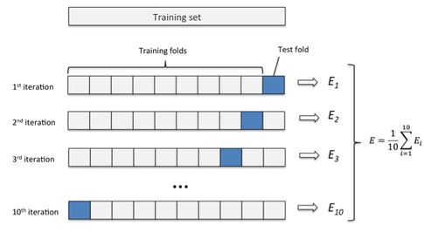

Slide 123




●
○
■
■
○
■
■

Slide 124
●

Slide 125

●
>>> from sklearn.model_selection import cross_val_score
>>> scores = cross_val_score(tree_reg, housing_prepared, housing_labels, scoring="neg_mean_squared_error", cv=10)
>>> tree_rmse_scores = np.sqrt(-scores)
K-fold Cross-Validation
10 folds

Slide 126
●
○
■
○
■
■
○

Slide 127
>>> def display_scores(scores): print("Scores:", scores) print("Mean:", scores.mean())
print("Standard deviation:", scores.std())
>>> display_scores(tree_rmse_scores)
Scores: [ 70232.0136482
66828.46839892 72444.08721003
70761.50186201 71125.52697653 75581.29319857 70169.59286164
70055.37863456 75370.49116773 71222.39081244]
Mean: 71379.0744771
Standard deviation: 2458.31882043

Slide 128
>>> lin_scores = cross_val_score(lin_reg, housing_prepared, housing_labels, scoring="neg_mean_squared_error", cv=10)
●
>>> lin_rmse_scores = np.sqrt(-lin_scores)
>>> display_scores(lin_rmse_scores)
Scores: [ 66782.73843989 66960.118071 70347.95244419
74739.57052552 68031.13388938 71193.84183426 64969.63056405
68281.61137997 71552.91566558 67665.10082067]
Mean: 69052.4613635
Standard deviation: 2731.6740018

Slide 129





Slide 131


●
○
○
●
○
○

Slide 132
●
○
●
○
○
●

Slide 133
●
>>> from sklearn.ensemble import RandomForestRegressor
>>> forest_reg = RandomForestRegressor(random_state=42)
>>> forest_reg.fit(housing_prepared, housing_labels)
>>> housing_predictions = forest_reg.predict(housing_prepared)
>>> forest_mse = mean_squared_error(housing_labels, housing_predictions)
>>> forest_rmse = np.sqrt(forest_mse)
Output - 21941.911027380233

Slide 134

●
>>> from sklearn.model_selection import cross_val_score
>>> forest_scores = cross_val_score(forest_reg, housing_prepared, housing_labes, scoring="neg_mean_squared_error", cv=10)
>>> forest_rmse_scores = np.sqrt(-forest_scores)

Slide 135
●
>> display_scores(forest_rmse_scores)
Scores: [ 51650.94405471 48920.80645498 52979.16096752
54412.74042021 50861.29381163 56488.55699727 51866.90120786
49752.24599537 55399.50713191 53309.74548294]
Mean: 52564.1902524
Standard deviation: 2301.87380392

Slide 136



Slide 137
●
●
○

Slide 140
●
●
○
○

Slide 141
●
●

Slide 142
●
●

Slide 143
●
●

Slide 144
●
○
●
○
●
○

Slide 145

●
○
●
○
○
○

Slide 146



●
●
●
○
○
○

Slide 147

●
●
○
●
●

Slide 148
●

Slide 149
●
●
●
●

Slide 151

●
○
●
○
○
●

Slide 152
●

Slide 153
>>> from sklearn.model_selection import GridSearchCV
>>> param_grid = [
{'n_estimators': [3, 10, 30], 'max_features': [2, 4, 6, 8]},
{'bootstrap': [False], 'n_estimators': [3, 10],
'max_features':[2, 3, 4]
},
]
>>> forest_reg = RandomForestRegressor()
>>> grid_search = GridSearchCV(forest_reg, param_grid, cv=5, scoring='neg_mean_squared_error')
>>> grid_search.fit(housing_prepared, housing_labels)

Slide 154
●
>>> grid_search.best_params_ Output-
{'max_features': 8, 'n_estimators': 30}

Slide 155
>>> grid_search.best_estimator_
●
Output-
RandomForestRegressor(bootstrap=True, criterion='mse', max_depth=None, max_features=8, max_leaf_nodes=None, min_impurity_decrease=0.0, min_impurity_split=None, min_samples_leaf=1, min_samples_split=2, min_weight_fraction_leaf=0.0, n_estimators=30,
n_jobs=1, oob_score=False, random_state=42, verbose=0, warm_start=False
)

Slide 156
●
>>> cvres = grid_search.cv_results_
>>> for mean_score, params in zip(cvres["mean_test_score"], cvres["params"]):
print(np.sqrt(-mean_score), params)

Slide 158
●
○
●
●

Slide 159

●
○
○
○
○

Slide 160
●
●
○
○
○

Slide 161
●
●
○
○

Slide 164

●
○
●
○
○
●
○
○

Slide 166
●
>>> feature_importances = grid_search.best_estimator_.feature_importances_
>>> extra_attribs = ["rooms_per_hhold", "pop_per_hhold", "bedrooms_per_room"]
>>> cat_encoder = cat_pipeline.named_steps["cat_encoder"]
>>> cat_one_hot_attribs = list(cat_encoder.categories_[0])
>>> attributes = num_attribs + extra_attribs + cat_one_hot_attribs
>>> sorted(zip(feature_importances, attributes), reverse=True)

Slide 167

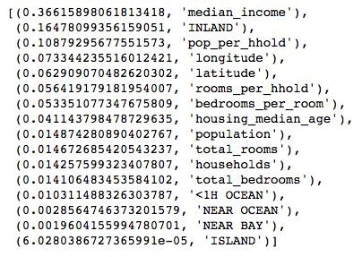

Slide 169
●
●
●

Slide 171
>>> final_model = grid_search.best_estimator_

Slide 172
# Predictors
>>> X_test = strat_test_set.drop("median_house_value", axis=1)
# Labels
>>> y_test = strat_test_set["median_house_value"].copy()

Slide 173
>>> X_test_prepared = full_pipeline.transform(X_test)

Slide 174
>>> final_predictions = final_model.predict(X_test_prepared)
# Calculate final RMSE
>>> final_mse = mean_squared_error(y_test, final_predictions)
>>> final_rmse = np.sqrt(final_mse)

Slide 175
>>> final_rmse = final_model.predict(X_test_prepared)
47,766.0039

Slide 176


Slide 177
●
●

Slide 178

●
○
○
●
○
○

Slide 179

●
●

Slide 182
●
○
○
○
○

Slide 183

●
●
○

Slide 185


Slide 186
●
○

Slide 187


Slide 188
●
○
○
●
○
○

Slide 189


●
●
●
○
○
■
■

Slide 190
●
●
○
●
○

Slide 191


Slide 192

●
○
○
●
○
○

Slide 194
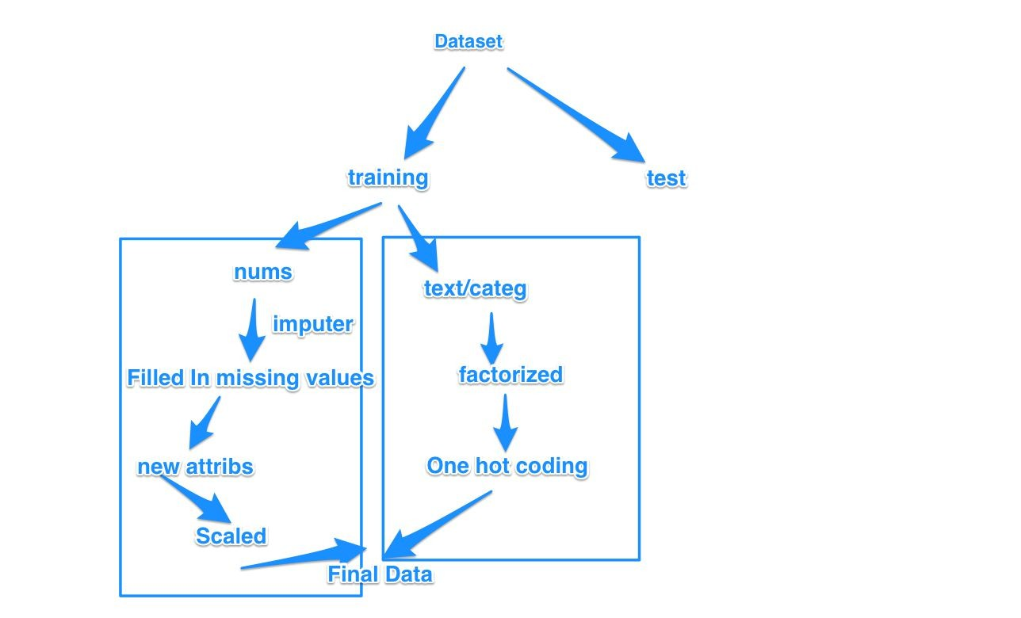

Slide 195

●
○
○
○
○
○

Slide 196
○
○
■
■
○

Slide 197







Slide 198


